Slide 1
PRESIDENCY UNIVERSITY
School of Engineering
Department of Computer Science and Engineering
UNIVESITY PROJECT-II
REVIEW-I
SCHOLARWISE
- EVERYTHING MADE EASY
BATCH NO: 17
BATCH MEMBERS UNDER THE GUIDANCE OF
PALTERU KAUSHIK - 20181CSE9046 Mr. KIRAN S(Asst. professor)
GIRISH K C - 20181CSE0228
GOGINENI VENKATA SATVIK – 20181CSE0229
GURUCHARAN DA – 20181CSE0254

Slide 2
OVERVIEW
Abstract
Literature Survey
Objectives
Existing Methods-Drawbacks
Proposed Method
Architecture Diagram
Modules
Hardware and Software Details
Time Line by Gantt Chart
References

Slide 3
Abstract
Social media is not just restricted to entertainment and networking; has extended roots to education.
Students use various digital platforms for different purposes.
One single platform for all the student activities.
SCHOLARWISE- socio-academic portal for students to access resources, get notified about placement and internship related opportunities.

Slide 4
Literature Survey
S.NO. | NAME OF THE AUTHORS, TITILE AND PUBLISHED YEAR | METHODS /ALGORITHMS /TECHNIQUES USED | MERITS | DEMERITS
1 | Garett, Renee Chiu, Jason Zhang, Website design and user engagement, 2016 | Selection criteria and data extraction | Best practices for facilitating or predicting user engagement. | Lack of quantitative evaluation of effective web design.
2 | Nigel Bevan, Usability issues in website design, 1999 | Expert inspection, Early mock-ups, functional prototypes | Management and Maintenance Ensure that new pages meet the quality and usability requirements. | The longer you wait to run a usability test, the more the problem soaks into the design, and the more difficult it will be to eliminate it over time.
3 | Grega Jakus1, Matija Jekovec2, New technologies for web development, 2010 | World Wide Web, HTML5, JavaScript, CSS3 | Coding with HTML5 is cleaner and consistent, storage options with HTML 5 are more reliable. | Gaming struggle with JavaScript under HTML5 and language is still in progress.
4 | Asha Mandava, Solomon Antony, A review and analysis of technologies for developing web applications, 2012 | Development practices | consistent design style across websites within the organization. | Most development work was done in an ad hoc Manner.
5 | Valentin Kuznetsov, Rapid web development using AJAX and Python, 2008 | Data discovery services and Web service integration | Faster page renders. | Failure of any one request can fail the load of the whole page.

Slide 5
Objectives
To build a socio-academic portal built for students to provide a holistic solution to all student needs.​
Provide academic resource with a single click.​
Notifying students about various college events, internships, and placements.​

Slide 6
Existing Methods-Drawbacks
Existing websites such as College space provide resources limitedly.
Don’t allow users to post information.
Info related to tests is not present.
Doesn’t have a social media interface.

Slide 7
Proposed Method
Access to resources like previous question papers, etc.
Placements and internships related posts and notifications.​
Student club promotions.
Reactions on every post.
Information of webinars.
Help center that includes frequently asked questions.​
The search option to find the desired information.​
Filter option to find information on the user’s wish.​

Slide 8
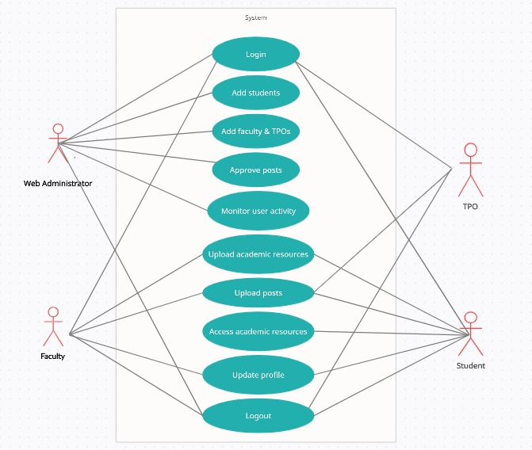
Architecture Diagram

Slide 9
Modules
The project includes three modules:
Admin Module:
a) Admin dashboard- Register student, Register faculty, manage users, approve posts, log in and log out.
Faculty Module
a) Log in credentials assigned by admin
b) Faculty dashboard- News feed, Upload academic resources, Upload posts, Log in and Log out.

Slide 10
Modules
TPO Module:
a) Exclusive for only training and placement officers.
b) TPO dashboard- Upload placement related info, Log in and Log out.
Student Module
a) Log in credentials assigned by admin
b) Student dashboard- News feed, Upload and access academic resources, Upload posts, Update profile, Log in and Log out.

Slide 11
Hardware and Software Details
MINIMUM HARDWARE REQUIREMENTS:
System :Pentium IV 2.4 GHz.
Hard Disk : 40 GB.
Monitor : 15-inch VGA Color.
Mouse : Standard Mouse.
Ram : 512 MB
Keyboard : Standard Keyboard
MINIMUM SOFTWARE REQUIREMENTS:
Operating System : Windows XP.
Platform : Web Technology
Tool : Notepad++, Sublime
Front End : HTML, CSS, JavaScript, Bootstrap
Back End : PHP, SQL

Slide 12
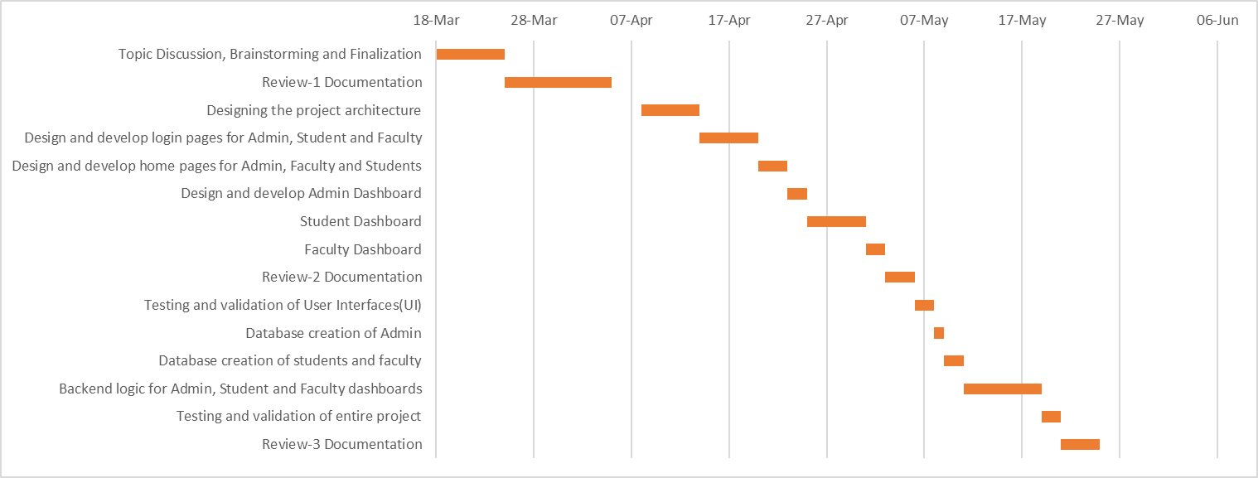
Time Line by Gantt Chart

Slide 13
References
https://collegespace.netlify.app/
https://developer.mozilla.org/en-US/
Website design and user engagement by Garett, Renee Chiu, Jason Zhang.
Usability issues in website design by Nigel Bevan.
New technologies for web development by Grega Jakus1, Matija Jekovec2.
A review and analysis of technologies for developing web applications by Asha Mandava, Solomon Antony.
Rapid web development using AJAX and Python by Valentin Kuznetsov.

Slide 14
Thank You!

Slide 15
Any Queries?

